Slide 1
Annual Meeting of the Members 17 October 2023

Slide 2
Past President’s Council
Focus
The Primary focus of the PPC is to provide advice and counsel to the National Elected Officials.
Proposals
Members are encouraged to comment on any of the proposals listed here, please complete the form below to contact the PPC.
The mission and function of the Past Presidents Council (PPC) is to assist the USAWOA Board of Directors in the organization and management of the United States Army Warrant Officers Association. We are organized to provide guidance and counsel based on our individual knowledge and experience.
We are not organized to replace the BOD nor the EXCOM, but rather to supplement their efforts to make the USAWOA as efficient and highly organized as possible.
Efforts contributed by the PPC will include but not be limited to:
Reviewing organizational directives to keep them current and applicable to the Association and the membership, not only as organized today, but also to ensure directives support future programs and growth.
Maximizing the utilization of technology
To represent the EXCOM and BOD members when they are unable to attend briefings, seminars, etc.
Assisting in office operations to reduce the workload of office staff
Assisting in the recruitment and retention of USAWOA members and staff
Acting as mentor to current Directors and Chapter Presidents as appropriate
Conducting one-time, special studies and analyses as requested by the BOD and EXCOM
The latest projects the PPC was asked to complete was updating the USAWOA Operations Manuals.

Slide 3
Past President’s Council Active Members

Slide 4
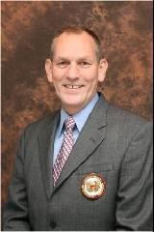
CW4 (Ret) Kenneth B.N. Hill became a member of the USAWOA. In 1987. He was appointed as the Eifel Chapter Secretary, and in 1988 he became the Chapter President, serving until 1990. CW4 Hill moved to Ft. Bragg in 1990 and became the Chapter Vice President. In 1991 he was elected the Chapter President. CW4 Hill was a member of the chapter for seven (7) years, serving on the picnic, golf tournament, membership, and scholarship committees. He also started the monthly awards program and the monthly newsletter, “Chief’s Talk.” CW4 Hill was then elected the Southeastern Region Director. CW4 Hill became Life Member #498 in May of 2000. CW4 Hill moved to Aberdeen Proving Ground in August of 1999 and was appointed the Northeast Region Deputy Director. He was also elected President of the Aberdeen-Edgewood “Silver” Chapter and served for two terms. After serving as Aberdeen-Edgewood “Silver” chapter president, CW4 Hill ran for and was elected the Northeastern Region Director. In May of 2000 he received the Samuel Sharpe Award and in 2006 was inducted into the US Army Ordnance Corps Hall of Fame. In 2008 CW4 Hill was recruited to serve and run for national USAWOA positions. In 2008, CW4 Hill ran for and was elected the USAWOA National Vice President. In 2010 he ran for and was elected the USAWOA National President. While the National President he formed the Junior Warrant Officer Advisory Committee, renamed the Company Grade Warrant Officer Advisory Committee. After completion of his time as the National President he was awarded the Honorable Order of the Eagle Rising Gold Award from the USAWOA. In 2014 CW4 Hill was elected as USAWOA National Secretary, and in 2018 was re-elected to the office of National Vice-President serving until 2020. In 2017 CW4 Hill was appointed the Chairperson and Co-Chair of the 100th Anniversary Celebration Committee, recognizing 100 years of warrant officer service to our nation. He continues to contribute to the USAWOA in numerous positions. CW4 Hill has organized and hosted five (5) USAWOA Annual Meeting of the Members and attended twenty (20) National Annual Meetings. Fully supporting his home chapter, the APG-EA “Silver”, he served as the Chapter Secretary from 2007 until 2013, and in the summer of 2013, he was appointed the Chapter Treasurer, a position he still serves to this day. CW4 (Ret) Kenneth B.N. “Pete” Hill, for his more than thirty-five (35) years of association leadership, was recognized by the U.S. Army Warrant Officer Career College (USAWOCC) and the Military Officers Association of America (MOAA) and inducted into the prestigious Order of the Rising Eagle Society. CW4 Hill was recognized with the Don Hess Lifetime Achievement Award in 2021 for 34 years of continued support CW4 Kenneth B.N. Hill remains an active member at all levels of the USAWOA and is a valued member of the USAWOA Past Presidents Council, providing invaluable wisdom, experience, and stewardship of the U.S. Army Warrant Officer Association. He is also a Charter member of the 1918 Society, member number 498.
Chairman

Slide 5
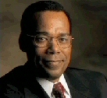
CW4 (Ret) Carl M. Burnett became a U.S. Army Warrant Officers Association (USAWOA) member in 1979. He was elected the Chapter President of the Stuttgart “Silver” Chapter from 1979 to 1980. In 1980 CW4 Burnett was elected the President of the Lord Fairfax “Silver” Chapter. He served as President until 1982. In 1984 CW4 Burnett was appointed to serve as the USAWOA National Vice-President and became Life Member 258 of the USAWOA. In 1984 CW4 Burnett was elected the National President of the USAWOA. During his term as National President, CW4 Burnett instituted the National Awards program, the USAWOA Scholarship Program, and the corporate affiliation with the Pentagon Federal Credit Union (PFCU) asking Past President, CW4 (Ret) Robert D. Scott to serve on the Board of Directors of the PFCU. In 2003 Past President CW5 (Ret) David E. Welsh asked CW4 Burnett to serve on the inaugural Board of Directors of the Warrant Officer Historical Foundation. In 2019 CW4 Burnett became charter member #9 of the 1918 Society. CW4 Burnett is also a member of the National Association of Minority Veterans (NAMVETS), and a Life Member of the U.S. Army Engineer Association (AEA), the Military Officers Association of America (MOAA), the Association of the United States Army (AUSA), and American Veterans (AMVETS). In 2020 CW4 (Ret) Carl M. Burnett was elected the Chairman of the USAWOA Past Presidents Council (PPC) and continues to serve as a valued member providing invaluable wisdom, experience, and stewardship of the U.S. Army Warrant Officer Association.

Slide 6
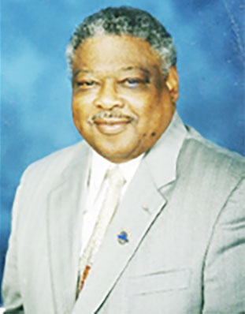
CW4 (Ret) Percy D. Butler entered the United States Army in May 1964. CW4 Butler received a direct appointment to a Warrant Officer In August 1970. CW4 Butler was a founding member of the European Region Warrant Officers Association (ERWOA) in 1971. Following discussions between CW4 (Ret) George C. Gratchen, President of the ERWOA, and CW4 (Ret) Donald E. Hess, President of the U.S. Army Warrant Officers Association (USAWOA) in Virginia, it was decided the two associations would merge into a single USAWOA. European Region would become Region 1 of the six regions of the USAWOA. CW4 Butler was instrumental in setting up this transition to an international USAWOA as a charter, founding member of both organizations. CW4 Butler was elected President of the Stuttgart “Silver” Chapter from 1976 to 1978. CW4 Butler was then elected President of the European Region from 1981 to 1982. Upon returning to the CONUS and retiring from the U.S. Army in 1984, CW4 Butler was elected the Southern Region Director of the USAWOA in 1985. CW4 Butler was appointed to serve as the Assistant Vice President for Veterans Affairs of the USAWOA in 1988. CW4 Butler was made a U.S. Presidential Appointee in 1993 by President Bill Clinton on the Veterans Administration Advisory Committee for National Cemeteries and Memorials. He was elected to serve as Vice Chairman and then Chairman for more than four years. CW4 Butler is Lifetime member 887 of the USAWOA and a member of the Veterans of Foreign Wars (VFW) and the American Legion. On May 30, 2014, CW4 Butler was inducted into the United States Army Adjutant General’s Corps Hall of Fame as a Distinguished Member of the Regiment (DMOR). CW4 Butler continues to serve on the USAWOA PPC as a valued member providing invaluable wisdom, experience, and stewardship of the USAWOA.

Slide 7
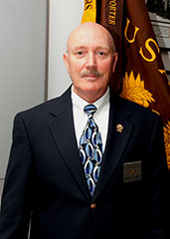
CW4 (Ret) Gregory A. Gouty enlisted in the Army in February of 1977. He was appointed a Warrant Officer in 1989. CW4 Gouty retired from active duty in February of 2005 with 28 years of dedicated service. He joined the Warrant Officers Association in 1989 and is a Life Member. CW4 Gouty has been a member of the Forever Forward Chapter at Fort Benning GA, the Sun City Chapter at Fort Bliss, TX, and the Aberdeen-Edgewood “Silver” Chapter at APG MD. CW4 Gouty has held the following Chapter positions: Treasurer, Vice President, and President. From 2008 to 2012 he served as the Northeastern Region Director. From 2012 to 2014 he served as the National Vice President and from 2014 to 2018 as the National President. He was inducted into the Ordnance Corps Hall of Fame in 2013 and is the recipient of the Samuel Sharpe Award. The USAWOA presented him with the Gold Level, Honorable Order of the Eagle Rising Award (HOERA). CW4 (Ret) Gregory A. Gouty remains an active member at all levels of the USAWOA and is a valued member of the USAWOA Past Presidents Council, providing invaluable wisdom, experience, and stewardship of the U.S. Army Warrant Officer Association.

Slide 8
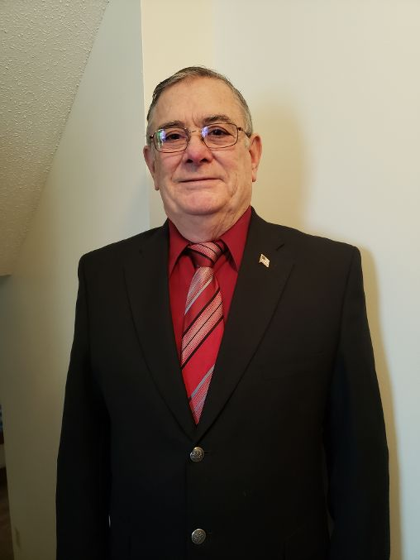
CW5 (Ret) Howard Lundin was inducted into the US Army in September 1968. Following 2 years of inducted service he served for 12 years as an Army Reservist and Army Reserve Civilian Technician before returning to full-time active duty in 1983. He was appointed a Warrant Officer in 1975. CW5 Lundin retired from active duty in October of 2006 with 38 years of dedicated service and was recalled from retirement for an additional year of active duty in 2010. CW5 Lundin joined the United States Army Warrant Officers Association in October 1986 and is a Life Member. CW5 Lundin has been a member of the Lord Fairfax “Silver” Chapter in Virginia, the Fort McCoy Chapter in Wisconsin, and the Star of the North Chapter in Minnesota. CW5 Lundin has held the following Chapter positions: Secretary, Treasurer, Vice President, and President. From 1988 to 1992 he served as both the Northeastern Region President and later as Northeast Region Director. CW5 Lundin is a recipient of the Adjutant General’s Corp Order of Horatio Gates Bronze Medal and the Major General Alexander Macomb Meritorious Achievement Award. While stationed in Washington DC from 1986-1992 and 1996-2000 CW5 Lundin worked closely monthly with the founding father Don Hess, Executive Director and Staff at USAWOA Headquarters and was an active participant in the monthly EXCOM meetings and WOA HQs activities. CW5 (Ret) Howard Lundin remains an active member of the USAWOA and is a valued member of the USAWOA Past Presidents Council, providing invaluable wisdom, experience, and stewardship of the U.S. Army Warrant Officer Association.

Slide 9
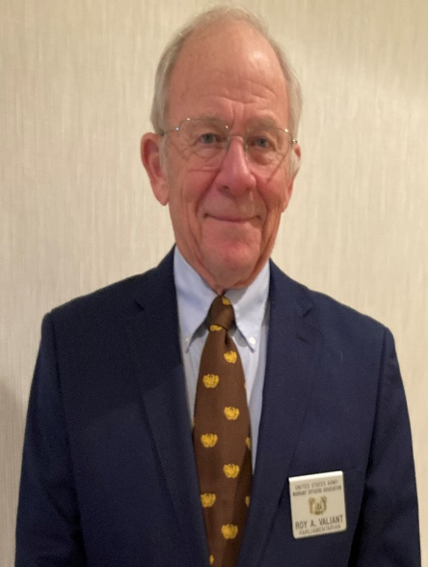
CW4 (Ret) Roy A. Valiant became a U.S. Army Warrant Officers Association (USAWOA) member in 1987 and was elected as the Hanau Silver Chapter President from 1987-1988. CW4 Roy A. Valiant was then elected as the European Region (ER) Vice-President from 1988-1990 when he was then elected to the office of European Region President and served from 1990-1993. CW4 Valiant worked with the then Warrant Officer Division (WOD) of PERSCOM to bring the Warrant Officer Assignment Managers to Europe for a Warrant Officer Professional Development Day during the annual ER Convention that brought approximately 800 Warrant Officers to the Heidelberg Officers Club for presentations and personal interviews with assignment managers. This was the largest group of Warrant Officers that WOD had participated in as of that date. CW4 Valiant worked with the APO mail system to enhance faster delivery of the Newsliner to the USAWOA members in Europe. CW4 (Ret) Valiant became a Life Member #363. CW4 Valiant was re-elected as European Region President 1997-2000 and was presented with the Don Hess President’s Award in 2000. During his time in Germany when he was not serving as European Region President or Vice-President, CW4 Valiant was Region Secretary, Region Parliamentarian, Region assistant VP for Professional Development, and the Heidelberg Chapter Treasurer. CW4 Valiant was elected as National Vice-President 2002-2004 and elected as National President 2004-2008. During his tenure as President, CW4 Valiant directed and oversaw the Newsliner transformation to a color publication comparable to other professional military association publications. CW4 Valiant served as the Aberdeen-Edgewood Silver Chapter President and is currently serving as the National Parliamentarian. The USAWOA presented him with the Gold Level, Honorable Order of the Eagle Rising Award (HOERA), and the Don Hess Lifetime Achievement Award. CW4 Valiant is a charter member of the 1918 Society. CW4 Roy A. Valiant remains an active member of the USAWOA and is a valued member of the USAWOA Past Presidents Council, providing invaluable wisdom, experience, and stewardship of the U.S. Army Warrant Officer Association

Slide 10
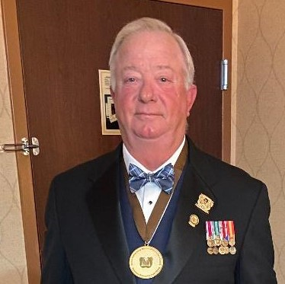
CW2 (Ret) Gerald (Gerry) J. Wentworth enlisted in the Army in April of 1977. He was appointed a Warrant Officer in 1990. CW2 Wentworth retired from active duty in May of 1997 with 20 years of dedicated service. He joined the Warrant Officers Association in 1990 and is a Life Member. CW2 Wentworth has been a member of several chapters OCONUS and CONUS. CW2 Wentworth has held the following Chapter positions: Secretary, Treasurer, Vice President, and President. CW2 Wentworth has held the following National Level positions: European President, National Secretary, Treasurer, and Vice-President and currently is the National Chaplain. The USAWOA presented him with the Gold Level, Honorable Order of the Eagle Rising Award (HOERA), and the Don Hess Lifetime Achievement Award. CW2 Wentworth remains an active member at all levels of the USAWOA and is a valued member of the USAWOA Past Presidents Council, providing invaluable wisdom, experience, and stewardship of the U.S. Army Warrant Officer Association.

Slide 11
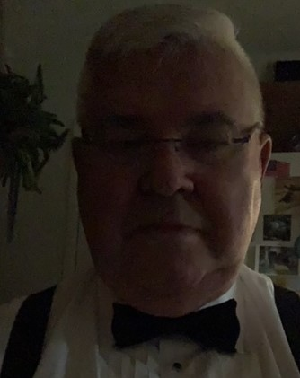
CW4 (Ret) Ronald J. Whalen became a U.S. Army Warrant Officers Association (USAWOA) member in 1974. Upon returning to the United States in 1977 he became a member of the Lord Fairfax where he served as Chapter President. He then became Northeast Region President until 1987. In 1978 CW4 Whalen was elected Secretary of USAWOA. In 1980 CW4 Whalen was elected Vice President of USAWOA. In 1982 CW4 Whalen was elected National President until 1984. In 2003, CW4 Whalen was asked to become a Founding Member of the Warrant Officer Historical Foundation as the Financial Officer. He served in that position for 10 years before retiring from the Foundation. In 2019 CW4 Whalen became a charter member of the 1918 Society. CW4 Ronald J. Whalen continues to serve on the USAWOA PPC as a valued member providing invaluable wisdom

Slide 12
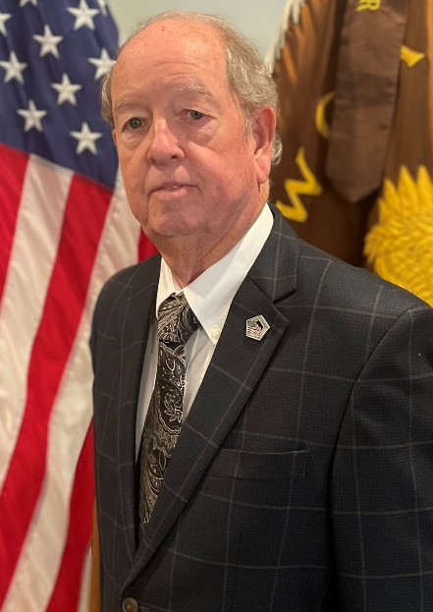
CW5 (Ret) Jim White joined the US Army in 1960, he was appointed a WOJG in 1968 and became a member of the Association many years ago, and in 2002 he became a Life Member. He has been active at the Chapter level in the Iron City and Keystone Chapters. He was the founder and first President of the Iron City Chapter, Oakdale, PA. While serving as Iron City Chapter’s President he was assigned as the 99th Regional Support Command Warrant Officer mentor for all active, reserve, and future Warrant Officer candidates. When he was elected Northeast Region Director, he made it his priority to stay in contact with all Chapter Presidents. He attended Regional Chapter meetings and conducted Council of Presidents (COP) meetings. One of his goals achieved during this time was spousal involvement through family functions. While the Northeast Region Director he had the opportunity to be a member of the Executive Committee (EXCOM) and attended monthly meetings. At the end of my term, he sought the office of USAWOA National Vice President and was elected. During his involvement with the USAWOA, he have worked with Chapters, Chapter Presidents, and Warrant Officers in recruiting and mentoring current and future Warrant Officers. As a Warrant Officer, he has developed and practiced skills of mentoring Warrant Officers and Warrant Officer Candidates through good communication, listening, advising, counseling, facilitating, and recruiting. CW5 White remains an active member at all levels of the USAWOA and is a valued member of the USAWOA Past Presidents Council, providing invaluable wisdom, experience, and stewardship of the U.S. Army Warrant Officer Association.

